Slide 1
Fixed Assets
Reconciling
Accounts Payable
audits

Slide 2
Fixed Assets Balancing
Do you reconcile your assets monthly?
Semi-Annually?
Annually?
CIP and Monthly Balancing
Fund Balancing

Slide 3
Monthly reconcilation
Tag and Enter all assets
Reports needed
  Trial Balance 700-799 object code
  Trial Balance 740
  Trial Balance 274 (less 740)
  Asset List – I prefer Excel version
  Donated Assets
  Warranty Replacements
  **Expenditure Budget List for CIP
    3034-900-5000-000-700-00
    3034-999-5999-999-799-99

Slide 4
Why the expenditure budget list for cip
Construction projects are assigned an asset tag when a PO is created. A spreadsheet for each project tracks expenses and changes. Architect fees, testing, engineering fees and advertising fees are all included in the total cost of each project. The assets are not added until the project is completed, the total of the Monthly Expenditure report will appear as a variance on each monthly reconciliation.
The spreadsheet is tracked by AP and expenses are added as PO’s are paid.
Why do we do it this way??
  Cuts down the number of asset entries for one project – one project one asset tag
  Asset entries are more accurate

Slide 5
Semi annual and annual reconciling
Formulas are set in Monthly Reconciliation to add at the end of 6 months and 12 months
Run corresponding reports to compare totals and review any discrepancies.
Verifies that assets are remaining in balance.

Slide 6
Balance each object Code
Asset List filtered by classification, Run in excel and filter out any warranty replacements &/or Donations. compare total to the Detail Journal

Slide 7
QUESTIONS??

Slide 8
ADDING ANOTHER LEVEL – FUND BALANCING
HOW TO CHECK TO ASSETS TO FUNDS
  Central Access Query Report to show fund expense.
  Run Query for each fund, export to excel creating tabs for each fund.
  Asset List Report for current acquisition date and each corresponding fund, export to excel.

Slide 9
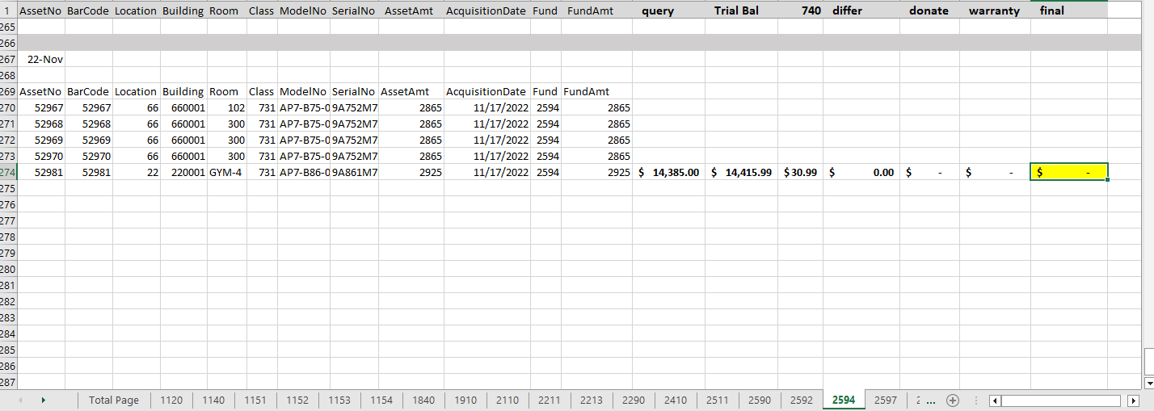
Information from Query
Report Totals

Slide 10
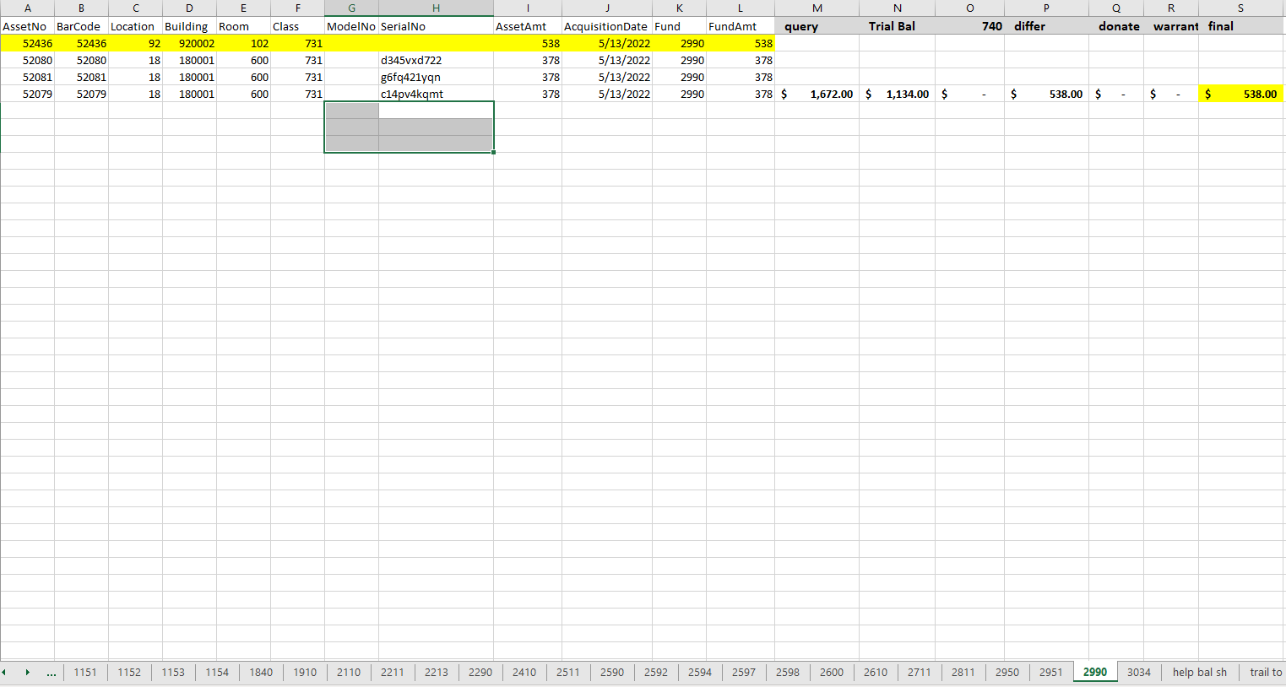
Review asset and PO information

Slide 11
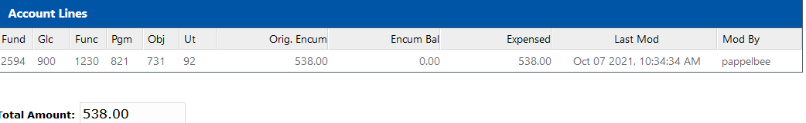
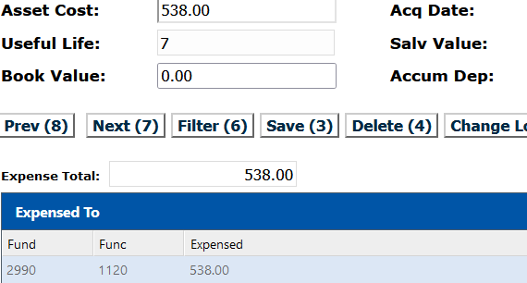
In this case the asset “expensed to” was
entered incorrectly.
The asset “expensed to” should be
corrected to correspond with
the PO and Trial Balance.

Slide 12
QUESTIONS?

Slide 13
Ap ~ fixed assets ~ ap
CODING – COMMUNICATION - corrections

Slide 14
CODING – COMMUNICATION – CORRECTIONS
Coding starts with the Schools – Two Bookkeeper Professional Development Days each year gives us the opportunity to share updates and information and reiterate codes.
Once a PO request is entered for approval, if there is a question regarding coding, there is discussion and research between Fixed Assets and AP until we agree on the object code.
Corrections: Reclassing object codes – the final check comes when the Report of Assets Purchased has been run and the PO’s and invoices are pulled for tagging assets. Reviewing the invoice before an asset is tagged is helpful in finding possible coding errors.

Slide 15
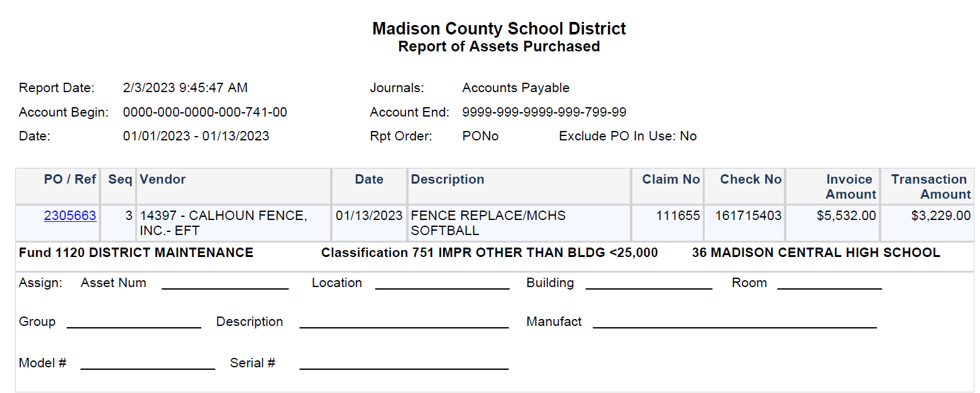

Slide 16
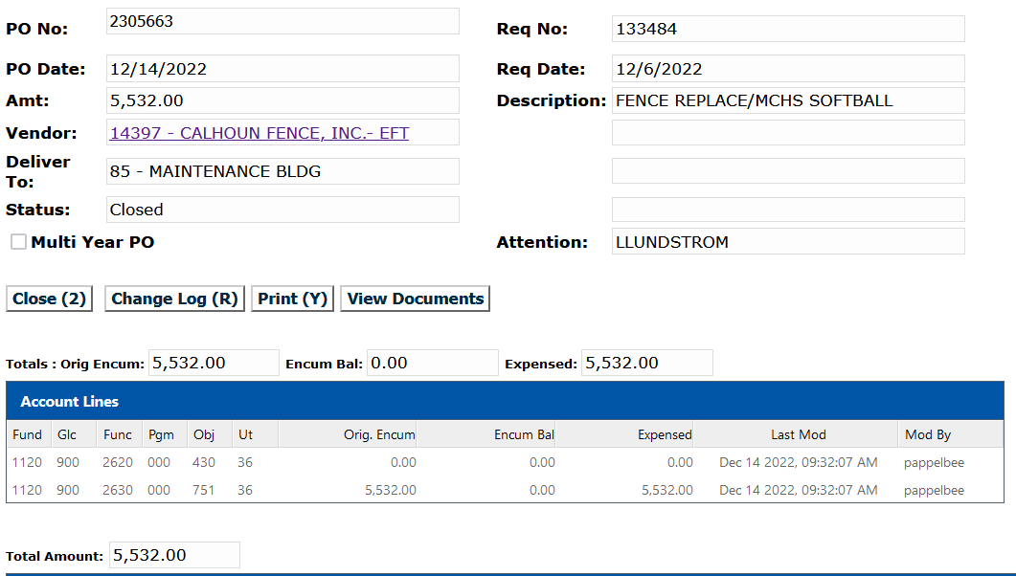

Slide 17
Examples of reclassing po object codes after po has paid and how it effects balancing assets.

Slide 18
Examples of reclassing po object codes after po has paid and how it effects balancing assets.

Slide 19
OBJECT CODES – TAGGED ASSETS
731 – COMPUTER EQUIPMENT =/> $250 per item BUT < $5000
733 – COMPUTER EQUIPMENT =/> $5000
735 – EQUIPMENT & FURNITURE =/> $1000 BUT < $5000
737 – EQUIPMENT & FURNITURE =/> $5000
751 – IMPROVEMENTS OTHER THAT BLDGS =/> $1000 BUT >$25,000 (FENCING, SIGNS, SPRINKLERS, SIDEWALKS, PLAYGROUND, ETC.)
753 – IMPROVEMENTS OTHER THAN BUILDINGS =/> $25,000 (FENCING, SIGNS, SPRINKLERS, SIDEWALKS, PLAYGROUND, ETC.)
771 – CARS & TRUCKS =/< $5000
772 – CARS & TRUCKS =/> $5000
775 – OTHER MOBILE EQUIP – (RIDING MOWERS/TRACTORS) =/< $5000
776 – OTHER MOBILE EQUIP – (MOWERS/TRACTORS – DEPRECIABLE) =/> $5000

Slide 20
HIGHLY WALKABLE – MUST BE TAGGED
(USE OBJECT CODE THAT APPLIES)
WEAPONS
CAMERAS & CAMERA EQUIPMENT GREATER THAT $250 per item
TWO WAY RADIO EQUIPMENT – INCLUDING WALKIE TALKIES
TELEVISIONS GREATER THAN $250
LAWN MAINTENANCE EQUIPMENT
CELL PHONES
COMPUTER & COMPUTER EQUIPMENT (GREATER THAT $250 per item – INCLUDES PROJECTORS, PRINTERS, CRICUT CUTTERS, SCANNERS, ETC.) Anything that must have a computer to function and serves no purpose without one.
CHAIN SAWS, WELDING MACHINES, GENERATORS, AIR COMPRESSORS
MOTORIZED VEHICLES – GOLF CART, SIDE BY SIDE, ETC.

Slide 21
Discussion???

Slide 22
audits

Slide 23
Fixed Assets
FALL AUDIT
Run Location/Building/Room Report – page break on building and room, check signature line. ALL BUILDING/ALL ROOMS.
Have occupants verify that all assets on the list are in the room and sign at the bottom. Have them write any missing or extra assets, also write any disposal request on the bottom of the report. Return to you.
You will review each room report, complete all transfer and disposal requests. Submit to CO any transfers or disposals as applicable. Remove any disposed assets from room and place in disposal location. Do not leave disposed assets in rooms. Submit to CO any transfers or disposals as applicable. Please be reminded, all technology devices are to be transferred to CO not disposed. Enter workorder to request transfer to Central Office – DTI – Rm WH13FA.
Once all transfers are made and all assets are located, run a new Location/Building/Room report, without signatures, page break on room. You or your Principal will sign the last total page and email this report to us. You will not have staff resign these pages. You will need to run a final report after all changes with a signature line and have staff sign those to post on their door.
Please keep a copy of the ones with the notes on it in your office, please don’t send both to us.
Please include a signed cover page with email report, stating that all assets are correct, must be signed by lead principal.

Slide 24
FALL AUDIT REPORT RECAP
You will run 3 building/room reports
  First one - give to staff to verify assets and make notes & corrections needed & sign.
  Second one – after all transfers, corrections and disposals are complete - building/room with no signatures – email this one to CO with signature on total page and cover sheet stating all asset are correct.
  Third one – when audit is complete building/room with signatures to post in rooms.

Slide 25
Jennifer Minninger
JMINNINGER@MADISON-SCHOOLS.COM
601-499-0732

