Slide 1
Travel Credit Cards
The Adventure Never Ends!

Slide 2
Travel Credit Cards
The Oxford School District has nine travel cards – one of which is solely used by the Superintendent.
Travel cards are physically signed out/in by the traveler prior to booking travel and taking the trip using a binder system with individual dividers and labeled tracking sheets.

Slide 3
Booking a Trip (screenshot from website)

Slide 4
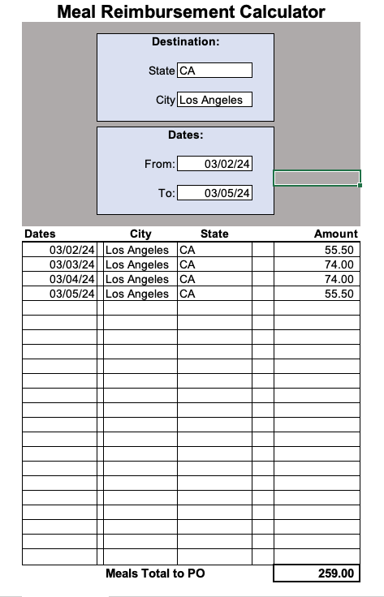
Meal Reimbursement Calculator
This spreadsheet uses the most recent location reimbursement rates from DFA.
Using drop-down boxes, the state and city are entered.
When travel dates are entered, the daily reimbursement amounts populate and total in the spreadsheet.
The spreadsheet is printed, signed and dated by the traveler, and included in the reimbursement packet.

Slide 5
Travel Checklist
This checklist is completed and signed by the employee for all travel-related purchase orders.
It is reviewed for completeness by the Business Office admin assistant.

Slide 6
Travel Card Sign Out/In Sheet

Slide 7
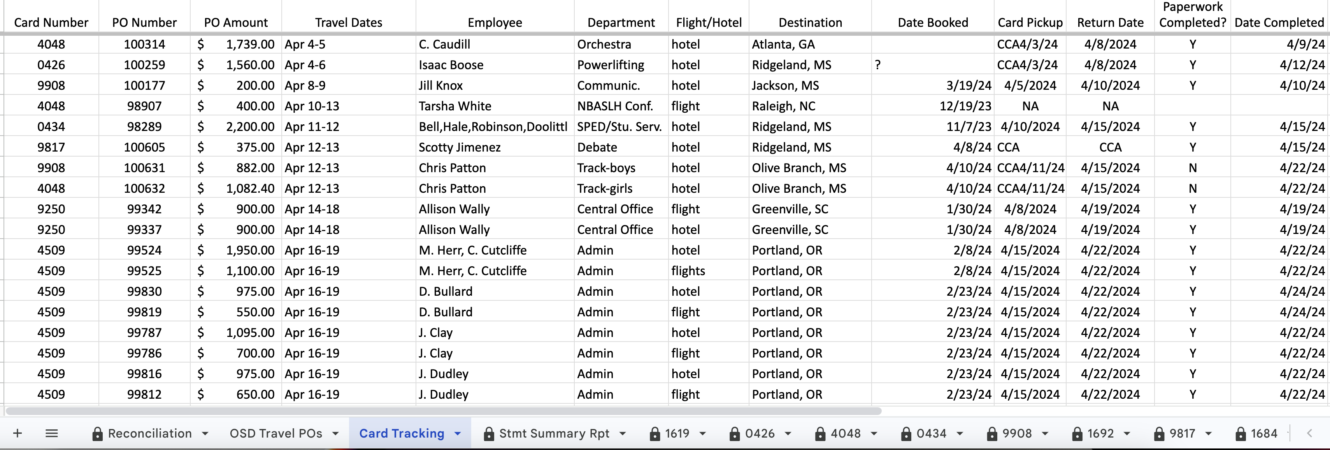
Tab for Tracking Travel

Slide 8
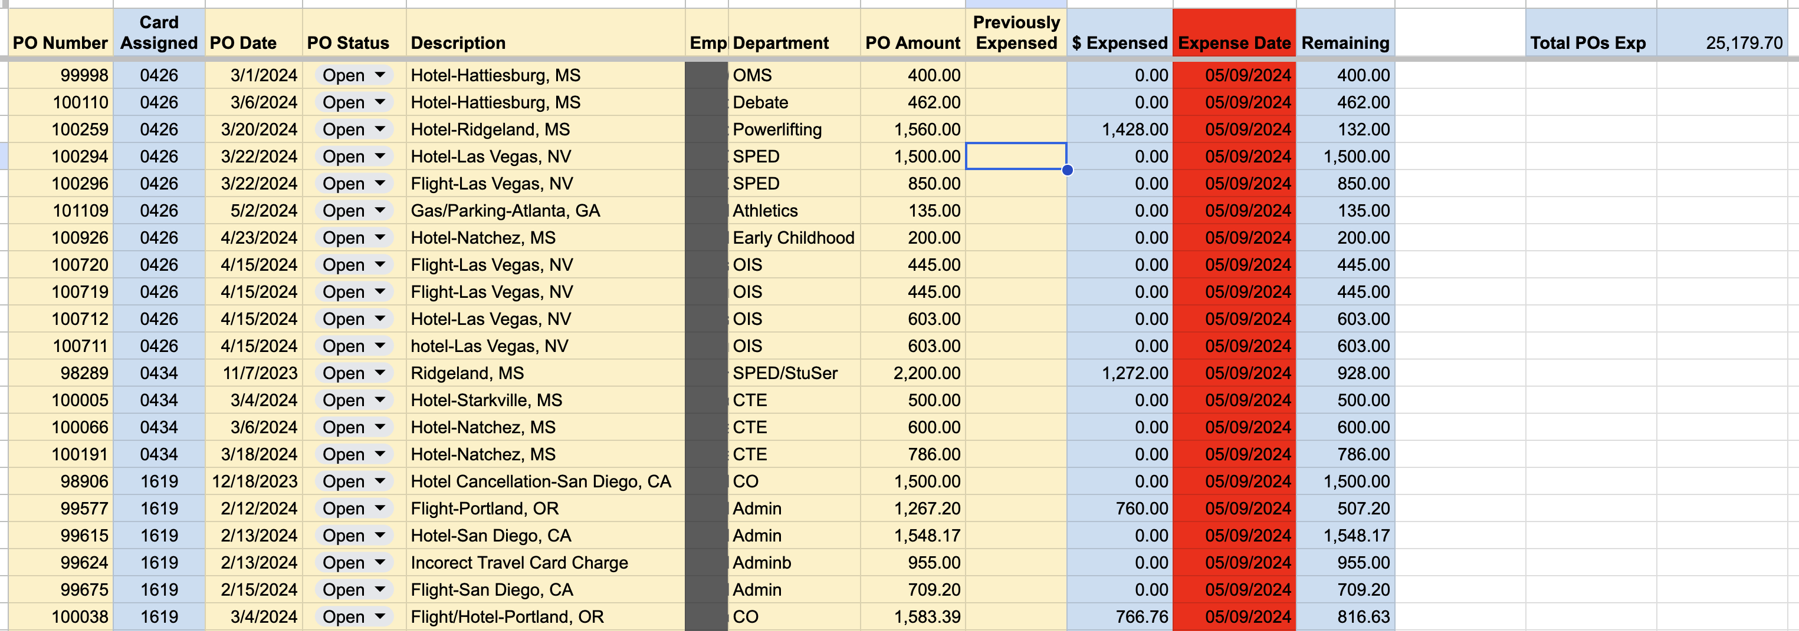
Tab of Expensed Travel POs

Slide 9
Travel Process – Separation of Duties
Traveler – check travel card out/in, obtain and submit all receipts, ensure no sales tax was charged in Mississippi
School Office Manager – create travel requisitions, book flight and hotel reservations, collect and review all receipts, complete and submit travel packets to Business Office
Business Office Administrative Assistant – track travel cards, collect and check paperwork, enter travel receipts in Marathon
Procurement Clerk – reconcile travel card statements with POs, enter travel card charges in reconciliation spreadsheet, check for discrepancies
Accounts Payable Clerk – reconcile travel card reconciliation with Marathon invoices, print travel card check

Slide 10
Reconciling the Travel Cards
Administrative Assistant
Copies and pastes individual statement activity into the separate card tabs in the spreadsheet.
Procurement Clerk
Each line is matched to a PO
Prints to Excel the individual travel card statements and the Statement Summary report from UMB.
Invoices each receipt in Marathon and gives the PO packets to the Accounts Payable Clerk for payment.
Accounts Payable Clerk
Runs Marathon reports, ties check amount to reconciliation spreadsheet

Slide 11
Individual Travel Card Tab

Slide 12
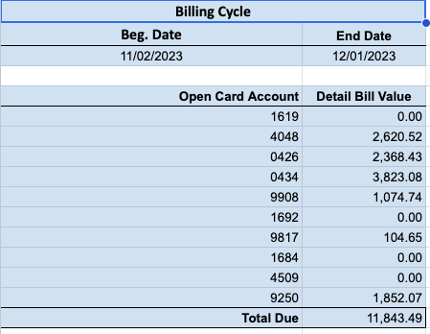
Statement Summary Report
The Statement Summary Report is populated from the individual card tabs.

Slide 13
Tab of Expensed Travel POs

Slide 14
Travel Reconciliation – The Reconciliation tab is populated from the Statement Summary Report tab, the OSD Travel POs tab, and the individual card tabs.

Slide 15
Paying for Travel
Accounts Payable Clerk totals the claims to Oxford School District Travel using the Marathon “PO/AP by Vendor Report” and enters this number on the Reconciliation tab of the Reconciliation Spreadsheet. These amounts should match.
If they match, the Accounts Payable Clerk prints a check to Card Services for the total amount of all eight travel cards.
If they do not match, the Accounts Payable Clerk, Procurement Clerk and Administrative Assistant review all charges and travel POs to locate the error/omission.

Slide 16
Questions and Comments

Slide 17
For more information, please contact: Karen Copple at kcopple@oxfordsd.org

